Slide 1

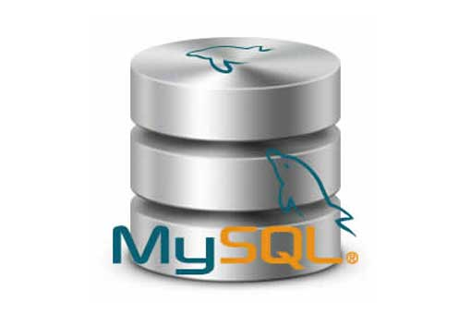
What is WSDL and UDDI?
Web Services
[Services available over the web]
To enable communication between two applications
Request
Application developed using Java and running on windows Operating System
Application developed using .NET and running on Linux Operating System
Response

Slide 2
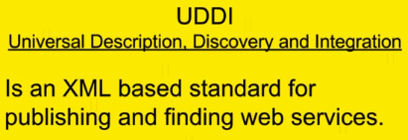
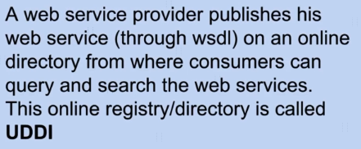

What is WSDL and UDDI?
WSDL
2
1
Get the WSDL and
use the Webservice
Creates WSDL
Request
Client
(Service Consumer)
Server
(Service Provider)
Response

Slide 3
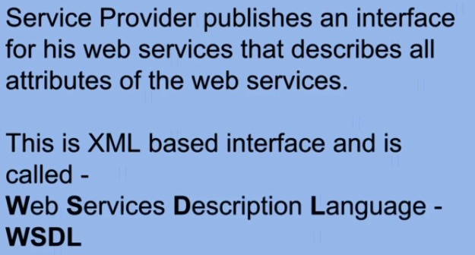


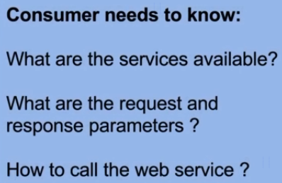
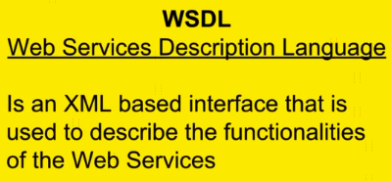
What is WSDL and UDDI?

